Slide 1
2019 New Product Road Map

Slide 2
Big Capactiy Battery Series

Slide 3
GQ3081
MP
April-2019
TM
OS
Android 9 Pie
Dimension
159.15x75.5x9.95mm
SIM
Nano SIM Card + Nano SIM Card/TF card
(3in2 Combo)
Chipset
MT6765(Helio P35) Octa-core 2.3GHz
Fingerprint
Back
Display
6.3-inch FHD+ (19.5:9)Waterdrop Screen
Resolution
2340x1080
Memory
4GB RAM+64GB ROM
Front Camera 16MP
Camera
Dual Rear Camera 16MP+0.3MP
Band
GSM: (B2/3/5/8); WCDMA: (B1/2/4/5/8);
FDD-LTE: (B1/2/3/4/5/7/8/12/17/18/19/20/25/26/66)
TDD-LTE：B40
Battery
5800mAh Battery/5V3A Fast Charge
Fingerprint ID/Face Unlock/OTG Function/
NFC+Android Pay/Dual 4G LTE/
G+P+L+Gyro Sensors/GPS
Other
Colors
Blue/Red/Black
Price
135SD MOQ 3K

Slide 4
GQ3073
MP
December-2018
OS
TM
Android 9 Pie
Dimension
159.3x75.8x10.7mm
SIM
Nano Sim card + Nano Sim card /
+ T card (3in2 combo)
Chipset
MT6739 Quad-core 1.3GHz
Fingerprint
Back
Display
6.0-inch HD+ 18:9
Resolution
720x1440
Memory
3GB RAM+32GB ROM
Front Camera 2MP
Camera
Dual Rear Camera 8MP+0.3MP
GSM: (B5/8/3/2） WCDMA: (B1/5/8）
FDD-LTE: (B1/3/7/8/20)
Band
Battery
6000mAh Battery/5V2A Fast Charge
Other
Face Unlock/Fingerprint ID/Smart Audio
Dual 4G LTE/GPS+GLONASS/OTG Function
Colors
Black/Gold/Twillight
Price
81USD MOQ 3K

Slide 5
Slim Series

Slide 6
April-2019
 |  | /
GQ3080
MP
TM
OS
Android 9 Pie
Dimension
156.1*73.7*9.7mm
SIM
Nano SIM Card + Micro SIM Card +TF card
Chipset
MT6761VWB Octa-core 2.0GHz
Fingerprint
Back
Display
Waterdrop Screen 6.1-inch HD-
Resolution
1280*600
Memory
3GB RAM+32GB ROM
Front Camera 5MP
Camera
Triple Camera 8MP+0.3MP+0.3MP
GSM: B2/3/5/8
WCDMA: B1/5/8
LTE-FDD: B1/3/5/7/8/20
Band
Battery
3200mAh Battery
Other
Fingerprint ID/Face Unlock/GPS+GLONASS/
G+P+L Sensors/Dual SIM Dual Standby
Colors
Black/Gold/Twilight
Price
70USD MOQ 3K

Slide 7
GQ3080
MP
April-2019
TM
OS
Android 8.1 (Go edition)
Dimension
156.1*73.7*9.7mm
SIM
Nano SIM Card + Micro SIM Card + TF card
Chipset
MT6580 Quad-core 1.3GHz
Display
Waterdrop Screen 6.1-inch
Resolution
1280*600
Memory
1GB RAM + 16GB ROM
Front Camera 5MP
Camera
Triple Camera 8MP+0.3MP+0.3MP
Band
GSM: B2/3/5/8
WCDMA: B1/2/5/8
Battery
3200mAh Battery
Other
Face Unlock/G+P+L Sensors/GPS+GLONASS
Colors
Black/Gold/Twilight
Price
50USD MOQ 5K

Slide 8
GQ3072
MP
December-2018
OS
Android 8.1
Dimension
167.6x80.3x8.65mm
SIM
Nano sim+Nano sim/TF card(3in2 combo)
Chipset
Helio P60 MT6771 Octa-core 2.0GHz
Fingerprint
Back
Display
6.7-inch FHD+ 19:9 SHARP Notch Screen
Resolution
1080x2280
Memory
8GB RAM+128GB ROM
6GB RAM+128GB ROM
4GB RAM+64GB ROM
Camera
8MP Front Camera
Dual Rear Camera 16MP+8MP
GSM: (B2/3/5/8); WCDMA: (B1/2/4/5/8);
CDMA: (BC0/BC1); TDSCDMA: (B34/B39);
LTE-DD: (B1/2/3/4/5/7/8/12/17/19/20/28A);
LTE-TDD: (B34/38/39/40/41)
Band
Battery
3900mAh Battery/9V2A Fast Charge
Fingerprint ID/Face Unlock
Support Qi 10W Wireless Charge
NFC+Android Pay
Other
Colors
Dark Green / Wine Red
Price
187USD(4+64GB) MOQ 3K

Slide 9
GQ3070
MP
October-2018
OS
Android 9 Pie
Dimension
149.2x72.2x9.65mm
Nano Sim card + Nano Sim card/T card (3in2 combo)
SIM
Chipset
MT6739 Quad-core 1.3GHz
Fingerprint
Back
Display
5.67-inch Notch HD+ 18:9 All Screen
Resolution
720x1498
Memory
2GB RAM + 16GB ROM
Front Camera 5MP
Camera
Dual Rear Camera 13MP+0.3MP
GSM: B2/3/5/8
WCDMA: B1/8
LTE-FDD: B1/3/7/8/20
Band
Battery
3200mAh Battery Built-in
Other
Face Unlock/Touch ID/
G+P+L Sensors, GPS
Colors
Black/Gold
Price
67USD MOQ 3K

Slide 10
GQ3068
MP
September-2018
OS
TM
Android 8.1 (Go edition)
Dimension
148.6x70.7x9.55mm
SIM
Nano Sim card + Nano Sim card/
T card (3in2 combo)
Chipset
MT6739 Quad-core 1.3GHz
Fingerprint
MT6580 Quad-core 1.3GHz
Display
5.5-inch FWVGA+ 18:9 All Screen
Resolution
480x960
Memory
1GB RAM + 8GB ROM
1GB RAM + 16GB ROM
Front Camera 2MP
Camera
Dual Rear Camera 8MP+0.3MP/5MP+0.3MP
GSM: B2/3/5/8
WCDMA: B1/8
LTE-FDD: B1/3/7/8/20
Band
GSM: B2/3/5/8
WCDMA: B1/8
Battery
2750mAh Battery removable
Other
Face Unlock/G/P/L Sensors/GPS
Colors
Black/Gold
Price
44USD(3G),54USD(4G) MOQ 5K

Slide 12
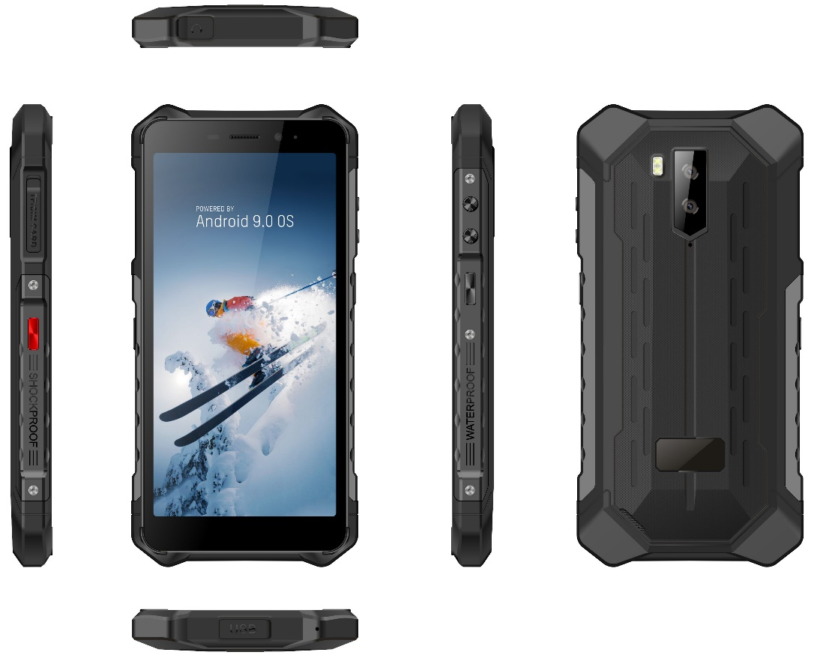
GQ3082
IP69K/IP68
MP
May-2019
OS
Android 9 Pie
TM
Dimension
158*77.5*13.85mm
SIM
Nano Sim Card + Nano Sim Card/T Card(3in2 combo)
Chipset
MT6580A Quad-core 1.3GHz
MT6761VWB Octa-core 2.0GHz
Display
5.5-inch HD+ 18:9 All Screen
Resolution
1440*720
Memory
2GB RAM + 32GB ROM
3GB RAM + 32GB ROM
Camera
Front Camera 5MP
Dual Rear Camera 8MP+0.3MP
GSM: B2/3/5/8
WCDMA: B1/2/4/5/8
LTE-FDD:B1/3/5/7/8/20
GSM: B2/3/5/8
WCDMA: B1/2/4/5/8
Band
Battery
4400mAh Battery
Other
Face Unlock/Fingerprint ID
G+D+L Sensors/ GPS
Colors
Black/Red
Price
79USD(3G 2+32GB) MOQ 3K
93USD(4G 3+32GB NFC)

Slide 13
GQ3065
IP68
MP
September-2018
OS
Android 8.1
Dimension
158.3x76x12.6mm
SIM
Nano Sim Card + Nano Sim Card/T Card (3in2 combo)
Chipset
MT6763 Octa-core 2.3GHz
Fingerprint
Back
Display
5.85-inch HD+ Oncell
Resolution
1512x720
Memory
4GB RAM + 64GB ROM
Front Camera 8MP
Camera
Dual Rear Camera 13MP+0.3MP
GSM: B2/3/5/8
WCDMA: B1/5/8
LTE-FDD: B1/3/7/8/20
Band
Battery
4400mAh Battery
NFC/G+P+L+Gyro Sensors/e-Compass/
Fingerprint ID/Face Unlock/Wireless
Charging/5V2A Fast Charge
Other
Colors
Black/Blue
Price
160USD MOQ 3K

Slide 14
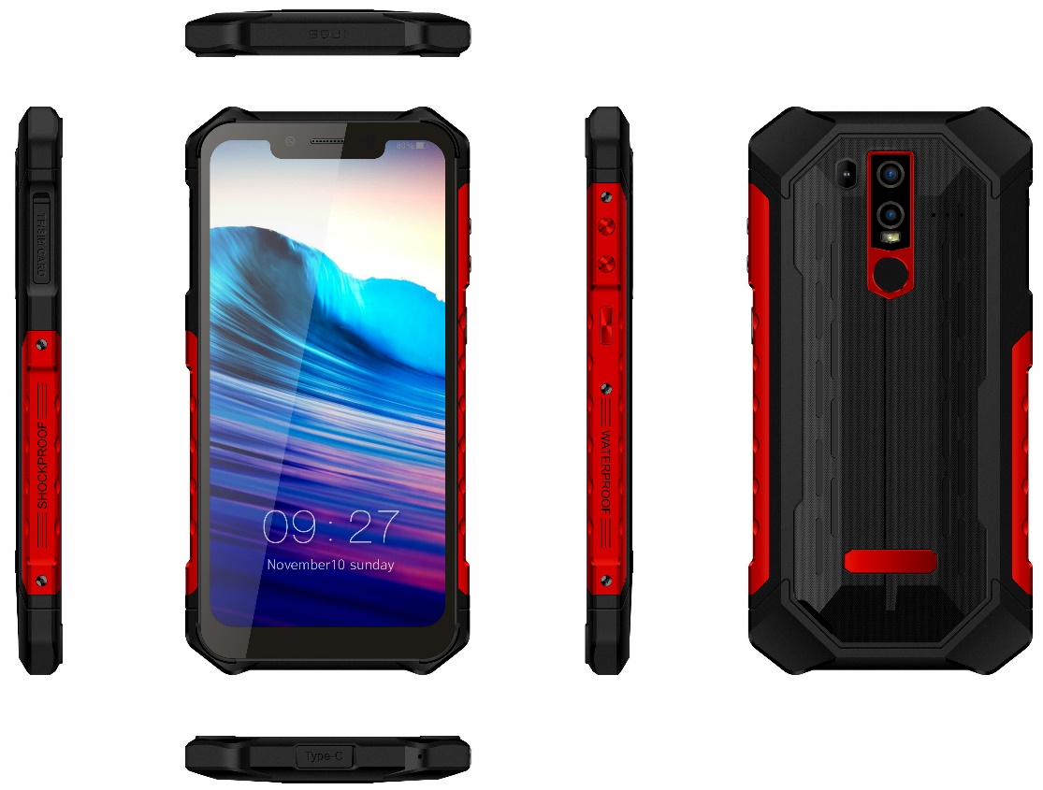
GQ3071
IP69K/IP68
MP
November-2018
OS
Android 8.1 Oreo
Dimension
166x83x13.3mm
SIM
Nano Sim Card + Nano Sim Card/T Card(3in2 combo)
Chipset
MediaTek MTMT6771V/C(Helio P60) Octa-core 64-bit 2.0GHz CPU
Fingerprint
Back
Display
6.2-inch FHD+ Corning Gorilla Glass 5
Resolution
1080x2246
4GB RAM + 64GB ROM / 6GB RAM + 128GB ROM (SD up to 256GB)
Memory
Camera
Front Camera 8MP
Dual Rear Camera 16MP+0.3MP
GSM: B2/3/5/8 WCDMA: B1/2/4/5/8
CDMA: BC0/BC1 TDWCDMA: B34/B39
LTE-FDD: B1/2/3/4/5/7/8/12/17/19/20/28A/28B
LTE-TDD: B34/38/39/40/41
Band
Battery
4400mAh Li-polymer Battery
GPS;GLONASS, Fingerprint sensor, 9V/2A Quick charge,
G-sensor, P-sensor、L-sensor, E-compass, Gyroscope,
NFC, UV Sensor, Baroceptor,OTG,NFC, Google Pay,
Face Unlock；
Other
Colors
Black/Red
Price
260USD MOQ 3K

Slide 15
GQ3060
IP69K/IP68
MP
May-2019
OS
Android 8.1 Oreo
Dimension
164.8*79.2*18.15mm
SIM
Nano Sim Card + Nano Sim Card+T Card
Chipset
MT6763T Octa-core 2.5GHz IDH: Agold
Display
5.7-inch FHD+ 18:9 All Screen
Resolution
2160*1080
Memory
4GB RAM + 64GB ROM
Camera
Front Camera 8MP
Rear Camera 21MP
Band
GSM: B2/3/5/8 WCDMA: B1/2/4/5/8
CDMA: BC0,BC1 TDSCDMA:B34/39
LTE-FDD:B1/2/3/4/5/7/8/12/13/17/18/19/20/25/26/28A/28B
LTE-TDD: B34/3//39/40/41
Battery
9400mAh Battery
GPS;GLONASS,Side-mounted Fingerprint sensor,
9V/2A Quick charge,Digital Compass,G-sensor,
Light Sensor, Proximity Sensor,OTG,NFC,
Google Pay,Face Unlock
Other
Colors
Black/Orange
Price
210USD MOQ 3K

Slide 16
GQ3059
IP68
MP
August-2018
OS
163*76.6*13.9mm
Dimension
Android 8.1
SIM
Nano SIM Card + Nano SIM Card +/TF card(3in2 Combo)
Chipset
MT6739 Quad-core 1.3GHz
MT6580 Quad-core 1.3GHz
Display
5.5-inch HD+ 18:9 All Screen
Resolution
1440*720
Memory
2GB RAM + 16GB ROM
Front Camera 5MP
Camera
Dual Rear Camera 8MP+0.3MP
Band
GSM: B2/3/5/8
WCDMA: B1/5/8
LTE-FDD: B1/3/7/8/20
Battery
5000mAh Battery
Other
GPS/OTG/NFC optional/Face Unlock/G+P+LSensors/Fingerprint ID/Wireless charging
Colors
Dark Gray/Silver/Rose Gold
Price
108USD(4G) MOQ 3K
90USD(3G no wiress charging)

Slide 17
Thanks !

